Slide 1
Predict the short-term evolution of stock prices
Presented by: Fatma Jemli

Slide 2
Outline
Problematic
State of the art
Experiments and results
Cnclusion and future work

Slide 3
Problematic

Slide 6
State of the art

Slide 7
Short-term evolution of stock prices?

Slide 8
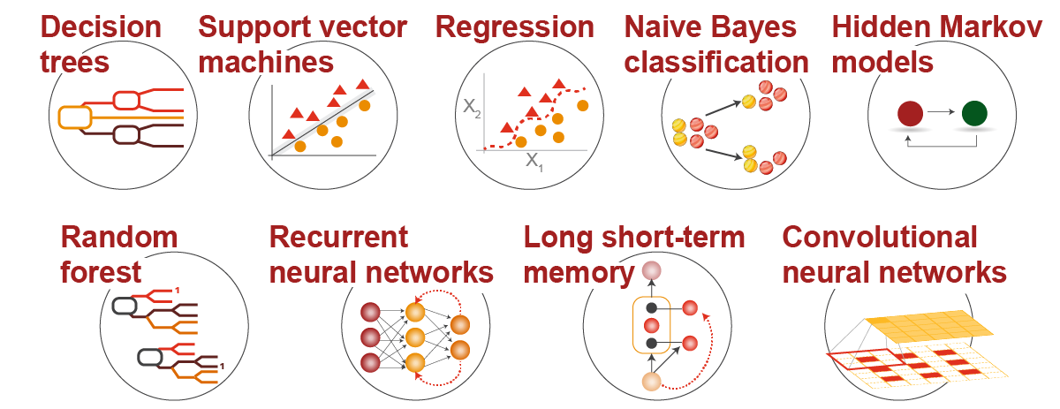
Prediction Methods

Slide 9
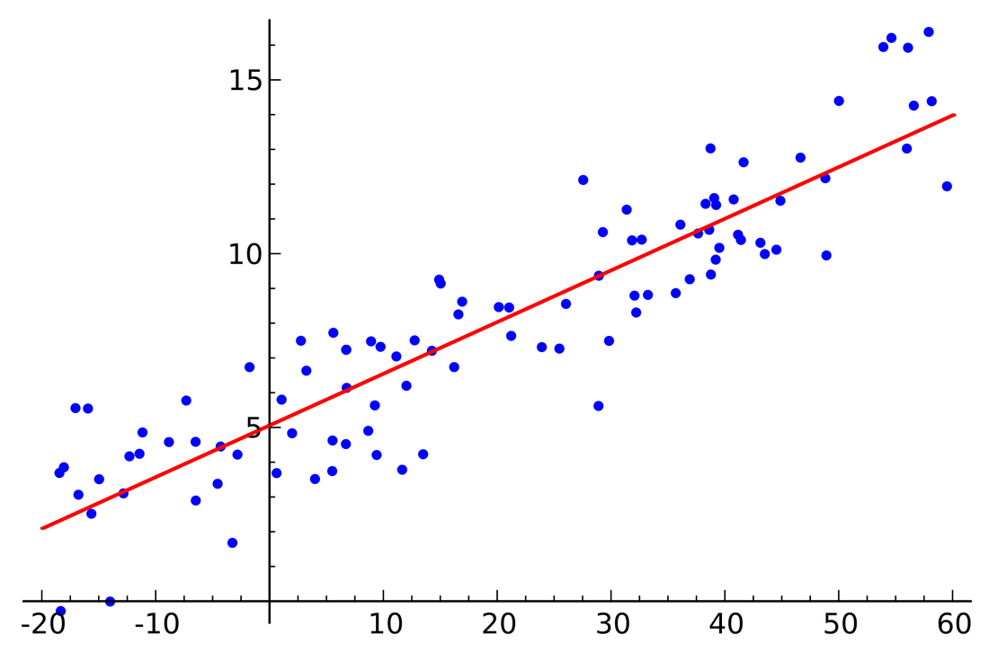
Regression
Predict value from observations
Predicted values are continuous
Supervised learning
Linear, Lasso, Ridge regression
House prices, stock exchange, power consumption, height of person …

Slide 10
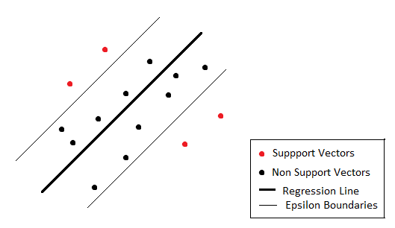
Support Vector Machines
Support Vector Machines are very specific class of algorithms, characterized by usage of kernels, absence of local minima, sparseness of the solution and capacity control obtained by acting on the margin, or on number of support vectors, etc.
Support Vector Machine can be applied not only to classification problems but also to the case of regression. Still it contains all the main features that characterize maximum margin algorithm: a non-linear function is leaned by linear learning machine mapping into high dimensional kernel induced feature space. The capacity of the system is controlled by parameters that do not depend on the dimensionality of feature space.
Notes:
http://kernelsvm.tripod.com/

Slide 11
K-nearest Neighbors
Given:
Training examples {Xi, Yi}
Xi attribute value representation of examples
Yi real valued target (profit, rating on Youtube, etc)
Testing point x that we want to predict the target
Algorithm:
Compute distance D(X, Xi) to every training example Xi.
Select k closest instances Xi1….Xik and their labels Yi1…Yik
Output the mean of Yi1…Yik
Notes:
https://www.youtube.com/watch?v=kbadomx9DIg

Slide 12
Applications

Slide 13
Experiments and results

Slide 14
Dataset

Slide 16
Data preprocessing

Slide 17
Regression Model Results

Slide 18
SVMs Model Results

Slide 19
KNN Model Results

Slide 20
Conclusion and Future Work

